Slide 1
M6 Project Leadership and Ethics
13-<number>

Slide 2
Project Leadership
Management
  Focuses on policies and procedures that bring order and predictability to complex organizational situations
  Is traditionally defined with such activities as planning, organizing, controlling, staffing, evaluating, and monitoring
Leadership
  Is different from management, although they tend to overlap
  Centers on vision, change, and getting results that involve setting direction, aligning people, and motivating them
13-<number>
Copyright 2012 John Wiley & Sons, Inc.

Slide 3
Leadership Is Different From Management
Leadership is different from management, but not for the reasons most people think. Leadership isn’t mystical and mysterious. It has nothing to do with having “charisma” or other exotic personality traits. It is not the province of a chosen few. Nor is leadership necessarily better than management or a replacement for it. Rather, leadership and management are two distinctive and complementary systems of action. Each has its own function and characteristic activities. Both are necessary for success in an increasingly complex and volatile business environment. (Kotter, 2001: p.3)
13-<number>
Copyright 2012 John Wiley & Sons, Inc.

Slide 4
Leadership Centers on Vision, Change, and Getting Results
Leaders inspire a shared vision. They gaze across the horizon of time, imagining the attractive opportunities that are in store when they and their constituents arrive at a distant destination. Leaders have a desire to make something happen, to change the way things are, to create something that no one else has ever created before. In some ways, leaders live their lives backward. They see pictures in their mind’s eye of what the results will look like even before they’ve started their project, much as an architect draws a blueprint or an engineer builds a model. Their clear image of the future pulls them forward. Yet visions seen only by leaders are insufficient to create an organized movement or a significant change in a company. A person with no constituents is not a leader, and people will not follow until they accept a vision of their own. Leaders cannot command commitment, only inspire it. (Kouzes & Posner, 2002; p. 15)
13-<number>
Copyright 2012 John Wiley & Sons, Inc.

Slide 5
Some Modern Approaches to Leadership
Kouzes & Posner (2002) conducted research for over 20 years on effective leardership
  Found leaders are often ordinary people who help guide others
  Defined Five Practices of Exemplary Leadership to help others become more successful leaders
13-<number>
Copyright 2012 John Wiley & Sons, Inc.

Slide 6
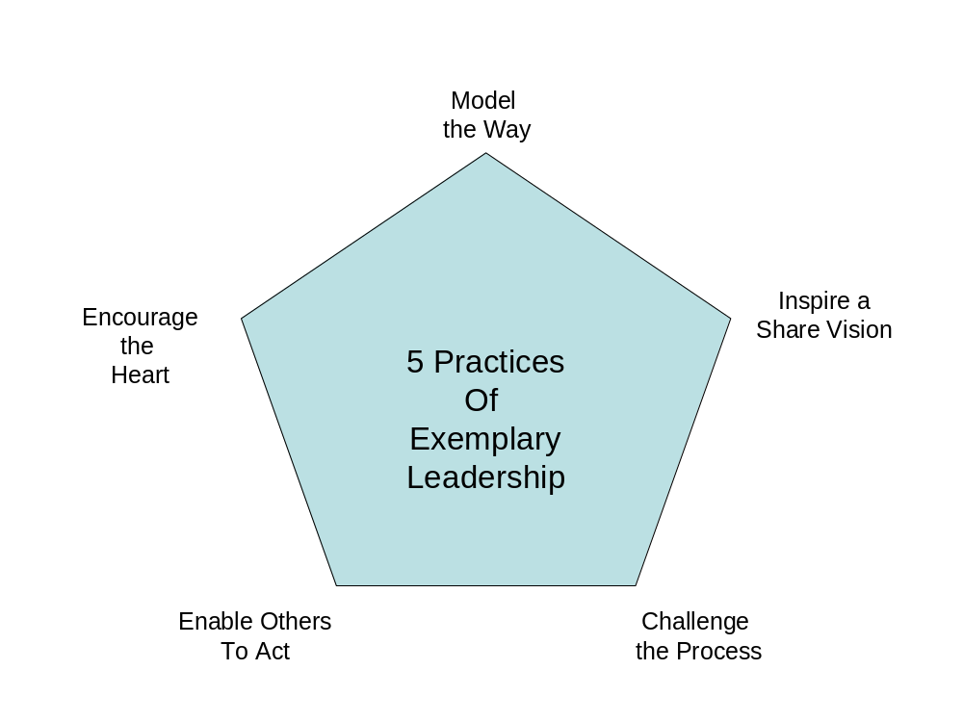
Five Practices of Exemplary Leadership
13-<number>
Copyright 2012 John Wiley & Sons, Inc.

Slide 7
Five Practices of Exemplary Leadership
Model The Way
  Most effective leaders lead by example
  A leader’s behavior wins respect, not title or position
  Find your own voice based on your personal values and beliefs, but what you do is often more important than what you say
  Modeling the way sets an example of what the leader expects from others and gives the leader the right to lead others
13-<number>
Copyright 2012 John Wiley & Sons, Inc.

Slide 8
Five Practices of Exemplary Leadership
Inspire a Vision
  Exemplary leaders have an exciting vision or dream that acts as a force to ignite a passion for what the future could be (i.e., inventing the future)
  This vision should inspire people so that they become committed to a purpose by
    Understanding their needs, interest, and language
    Engaging in dialogue, not monologue
13-<number>
Copyright 2012 John Wiley & Sons, Inc.

Slide 9
Five Practices of Exemplary Leadership
Challenge the Process
  Exemplary leaders venture out and accept challenges not the status quo
    They look for new opportunities to innovate, grow and improve
  But most leaders do not create, develop, or come up with new products, services, or processes
    They are often good listeners who recognize good ideas, support those ideas, and then challenge the process to make those ideas happen
    They minimize the risk of failure for others while making people feel safe and comfortable in taking risks
13-<number>
Copyright 2012 John Wiley & Sons, Inc.

Slide 10
Five Practices of Exemplary Leadership
Enable Others to Act
  Leaders must get others to act by encouraging collaboration and building trust among the project stakeholders
  Leaders provide an environment that makes it possible for others to do good work
  People should feel empowered and motivated to do their best, feel a sense of ownership, and take pride in what they do
  Leaders should give power away, not hang on to it
  In short, a leader must turn his or her followers into leaders themselves
13-<number>
Copyright 2012 John Wiley & Sons, Inc.

Slide 11
Five Practices of Exemplary Leadership
Encourage the Heart
  Exemplary leaders rally others to carry on by encouraging the heart
    Can be simple gestures such as a thank-you note or more dramatic such as a marching band
  The leaders should show appreciation for people’s contributions and create a culture to recognize accomplishments
    Recognition and celebration should not be phony or lame
    Must visibly link rewards with performance
  Authentic rituals and celebration that align with a team’s values can build a strong collective identify and spirit that can carry the team throughout the project journey
13-<number>
Copyright 2012 John Wiley & Sons, Inc.

Slide 12
Leadership Styles
Many effective leaders have a collection of distinct leadership styles
A study of 3,871 executives worldwide by Daniel Goleman in 2000 suggests that the best leaders do not rely only on one leadership style, but may use several different styles depending on the situation
The following six styles can be used in influence performance and results
  The Coercive Style
  The Authoritative Style
  The Affiliative Style
  The Democratic Style
  The Pace Setting Style
  The Coaching Style
13-<number>
Copyright 2012 John Wiley & Sons, Inc.

Slide 13
Leadership Styles:
The Coercive Style
Attitude: “Do as I say.”
Can be effective in a crisis situation, kick start a turnaround situation, dealing with a problem employee, or when trying to achieve immediate compliance
Can be ineffective in many other situations and can have a negative impact on the climate of the organization or project
  Can obstruct new ideas and limit communication
  People can become resentful or disillusioned thus leading to a loss of initiative, motivation, commitment, and sense of ownership
13-<number>
Copyright 2012 John Wiley & Sons, Inc.

Slide 14
Leadership Styles:
The Authoritative Style
Attitude: “Come with me!”
The leader outlines a clearly defined goal but empowers people to choose their own means for achieving it
Authoritative leaders provide vision and enthusiasm
  Shows how peoples’ work fits into the large picture
  People believe their work has meaning and purpose
  Standards for success and performance are clear to everyone
The authoritative style works best when the organization or project is adrift
Not a good style for inexperienced leaders who work with experts or a more experienced team
  The leader can undermine an effective team if he or she appears pompous, out of touch, or overbearing
13-<number>
Copyright 2012 John Wiley & Sons, Inc.

Slide 15
Leadership Styles:
The Affiliative Style
Attitude: “People come first!”
Affiliative leaders try to build strong emotional bonds that translate into strong loyalty by attempting to keep people happy and creating harmony among them
  The idea is that people who like each other tend to communicate more, share ideas & inspirations, and take risks
  The leader does not impose unnecessary rules and structures to define the work – that’s up to those who must do it
Works well in situations where the leader must build team harmony, morale, trust, or communication
Does not work well where people need some structure or direction
  An over-caring and over-nurturing approach can create a perception that mediocrity is tolerated
13-<number>
Copyright 2012 John Wiley & Sons, Inc.

Slide 16
Leadership Styles:
The Democratic Style
Attitude: “What do you think?”
The leaders try to get other’s ideas, while building trust, respect, and commitment
People have a greater say in the decisions that affect their work
  Morale tends to be higher
  More realistic idea of what can or cannot be done
Works best when the leader needs buy-in, consensus or to gain valuable input from others
But can lead to seemingly endless meetings or the perception that the group is leaderless
  Not appropriate in a crisis or when the team does not have competence or experience to offer sound advice
13-<number>
Copyright 2012 John Wiley & Sons, Inc.

Slide 17
Leadership Styles:
The Pacesetting Style
Attitude: “Do as I do, now!”
Leader sets high performance standards and has an obsession for doing things better and faster
  Poor performers are quickly identified and replaced
  Morale can deteriorate if people feel overwhelmed by the pace or demands for excellence or performance
  Goals may be clear to the leader, but not to everyone else
    The leader may try to micromanage by taking over the work of others
  People may lose energy and enthusiasm if the work becomes task-focused, routine, and boring
  If the leader leaves, people may feel adrift since the pacesetter sets all direction
May be appropriate in situations that require quick results from a highly motivated, self-directed, and competent team
13-<number>
Copyright 2012 John Wiley & Sons, Inc.

Slide 18
Leadership Styles:
The Coaching Style
Attitude: “Try this!”
The leader helps people identify their unique strengths and weaknesses so that they can reach their personal & career goals
The leader is good at delegating and giving people challenging, but attainable, assignments
  Short or minor failures are acceptable and viewed as positive learning experiences
This style may be the least often used, but can be a valuable and powerful tool for improving performance and the climate of the organization or project
  Works well in many situations, but is most effective when people are willing to be coached
  Least effective when people are resistant to change or when the leader does not have the knowledge, capability, or desire to be a coach
13-<number>
Copyright 2012 John Wiley & Sons, Inc.

Slide 19
Ethics in Projects
Ethics can be defined as a set of moral principles and values
Ethical dilemmas arise when our personal values come into conflict
Employers should establish guidelines for ethical conduct just as they do for other work-related behaviors such as what time to arrive and leave the workplace, whether smoking is allowed, and how customers are to be treated, etc.
Leaders should identify appropriate and inappropriate conduct and then communicate their expectations
13-<number>
Copyright 2012 John Wiley & Sons, Inc.

Slide 20
Ethics in Business
Ethics has become an increasing popular topic in business and in business schools as a result of number of ethical meltdowns in organizations
Unethical business behaviors
  Cost money
  May be illegal and result in jail time
  Are just bad for business!
    People want to work for and do business with organizations and people they can trust
Unfortunately, ethical decisions are not always clear cut
  To a large degree legality and ethics are governed by society and culture – i.e., the shared beliefs, assumptions, and values that we learn and that guide or influences our behavior
13-<number>
Copyright 2012 John Wiley & Sons, Inc.

Slide 21
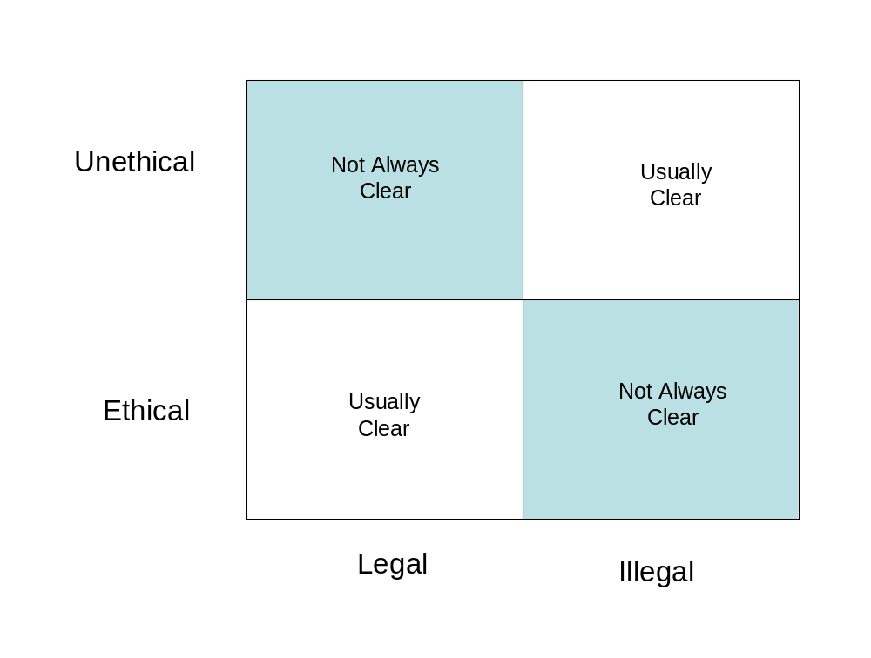
Ethics Versus Legality
13-<number>
Copyright 2012 John Wiley & Sons, Inc.

Slide 22
Ethical Leadership
Socialization
  A process where people who are brought into an organization learn its culture
  Can be through formal means (e.g., training) or through less formal means (e.g., interactions with supervisors and coworkers)
  New people learn not only how to dress appropriately, but what behaviors are acceptable and unacceptable
  Subsequently, socialization can encourage or discourage ethical behavior
13-<number>
Copyright 2012 John Wiley & Sons, Inc.

Slide 23
Ethical Leadership
People look to their leaders for ethical guidance
  If the leader does not provide this guidance, people may seek others who may intentionally or unintentionally lead them toward unethical behaviors
A project manager must therefore act as a moral individual and a moral manager/leader who defines the right set of values and sends the right message to shape an ethical culture
Leaders can be fall into 4 categories
  Unethical Leaderships
  Hypocritical Leadership
  Ethically Neutral Leadership
  Ethical Leadership
13-<number>
Copyright 2012 John Wiley & Sons, Inc.

Slide 24
Ethical Leadership
Unethical Leadership
  Usually weak moral individuals and weak moral managers
  Example: Al “Chainsaw Al” Dunlap
    A successful business leader, but was known for emotionally abusing employees
    Subordinates were expected to “make the numbers at all costs”
    As a result, people used questionable accounting practices and sales techniques
    He was caught lying and trying to cover up these practices
    Was fired as Sunbeam’s CEO when the company was near ruin
    Paid a $500,000 settlement with the SEC and can never serve as an officer of a publicly traded company again
13-<number>
Copyright 2012 John Wiley & Sons, Inc.

Slide 25
Ethical Leadership
Hypocritical Leadership
  Possibly the worst type of leader because he or she extols the virtues or integrity and ethical conduct, but then engages in unethical behavior, encourages others to do so, rewards bottom-line results by any means, or fails to discipline any wrongdoing
  Example: Jim Bakker
    Developed the PTL Ministries in the 1970s and 1980s into the largest religious broadcasting empires
    Bakker took in millions of dollars by convincing people to purchase a limited number of life memberships for hotels that were part of a theme park
    Only 25,000 memberships were to be sold that would allow a family to stay free each year for 4 days/3 nights
    However, 66,000 memberships were sold (an impossible number for the hotel to support) and Jim and his wife, Tammy Faye, used this money for large salaries and bonuses
    In 1987 the PTL filed for bankruptcy and in 1989 Jim Bakker was convicted of fraud and spent the next 8 years in prison
13-<number>
Copyright 2012 John Wiley & Sons, Inc.

Slide 26
Ethical Leadership
Ethically Neutral Leadership
  A leader who is not a strong or weak ethical leader, but does not provide clear ethical guidance. People may not know the leader’s ethical beliefs or whether the leader cares.
  Example: Sandy Weill
    Was chairman of the board at Citigroup
    An article in Fortune magazine in 2002 described Citigroup as a moneymaking machine that engaged in a number of questionable business practices that allegedly helped Enron hide debt
    Afterwards, Weill told Citigroup’s board of directors that his most important task would be that Citigroup would now operate at the highest level of ethics and integrity
    Weill can be viewed as a ethically neutral leader since he seemed to look the other way and appeared to take notice only after these problems became public
13-<number>
Copyright 2012 John Wiley & Sons, Inc.

Slide 27
Ethical Leadership
Ethical Leadership
  Someone who makes it clear that bottom line results are important, but only if they can be achieved in an ethical manner.
  Research suggests that when a culture is viewed as being ethical, employees tend to engage in fewer unethical behaviors, are more committed to the organization, and more willing to report problems to management
13-<number>
Copyright 2012 John Wiley & Sons, Inc.

Slide 28
Common Ethical Dilemmas
Human Resource Situations
  Project leaders should create a project environment where people feel safe and appreciated so they do their best work
  Issues that can lead to ethical situations include: discrimination, privacy, sexual or other types of harassment, as well as appraisals, discipline, hiring, firing, and layoffs
  Key considerations should be fairness in terms of equity (only performance counts), reciprocity (expectations are understood and met), and impartiality (prejudice and bias are not factors)
13-<number>
Copyright 2012 John Wiley & Sons, Inc.

Slide 29
Common Ethical Dilemmas
Conflicts of Interest
  Includes such things as overt or subtle bribes or kickbacks as well as relationships that could question your impartiality
  Impartiality can come into question when personal and professional relationships overlap and a conflict of interest can occur
    Could a gift or personal favor from a vendor or customer be viewed as having an influence on your judgment or a decision?
  Trust is a key factor in personal and business relationships, and conflicts of interest can weaken trust if special favors are extended to only a special few
13-<number>
Copyright 2012 John Wiley & Sons, Inc.

Slide 30
Common Ethical Dilemmas
Confidence
  Relationships with project stakeholders require maintaining a strong sense of confidence with respect to such issues as confidentiality, product safety or reliability, truth in advertising, and special fiduciary responsibilities to the client or other project stakeholders
  Trust can erode when your fairness, honesty, or respect come into question
13-<number>
Copyright 2012 John Wiley & Sons, Inc.

Slide 31
Common Ethical Dilemmas
Corporate Resources
  You are an agent or representative of your organization and your actions can be considered the actions of your organization
    This may include your opinions or actions, especially if you use corporate resources such as stationary, business cards, an email address, phones, etc for personal reasons
  Company resources should only be used for business unless the organization has specific policies
13-<number>
Copyright 2012 John Wiley & Sons, Inc.

Slide 32
Making Sound Ethical Decisions
Gather the Facts
Define the Ethical Issue
Identify the Affected Stakeholders
Identify the Consequences
Identify the Obligations
Consider Your Character and Integrity
13-<number>
Copyright 2012 John Wiley & Sons, Inc.

Slide 33
Multicultural Projects
Although an international project may be considered a multicultural project, many domestic projects are becoming multicultural as organizations attempt to diversify their workforce
Even though ethics is an important component of leadership, the ability to lead and manage a multicultural team is becoming an important skill for successful project leaders
13-<number>
Copyright 2012 John Wiley & Sons, Inc.

Slide 34
The Challenge of International Projects
Number of locations
Currency exchange
Regulations and laws
Political instability
Attitude toward work and time
Religion
Language
Food
13-<number>
Copyright 2012 John Wiley & Sons, Inc.

Slide 35
Understanding and Managing Diversity
While culture is a set of social lessons of behaviors that we learn over time, diversity is defined as differences in culture as well as nationality, ethnicity, religion, gender, or generation
The Diversity Wheel provides a tool to better understand individual differences
  It can remind us that even though some people may appear to look like us, they may represent a different culture even within our own country or region
  We can then begin to understand how each dimension of the Diversity Wheel influences attitudes, motivations, and behaviors, as well as social and business customs
  We can then not only see how people are different, but also how we might be similar
13-<number>
Copyright 2012 John Wiley & Sons, Inc.

Slide 36
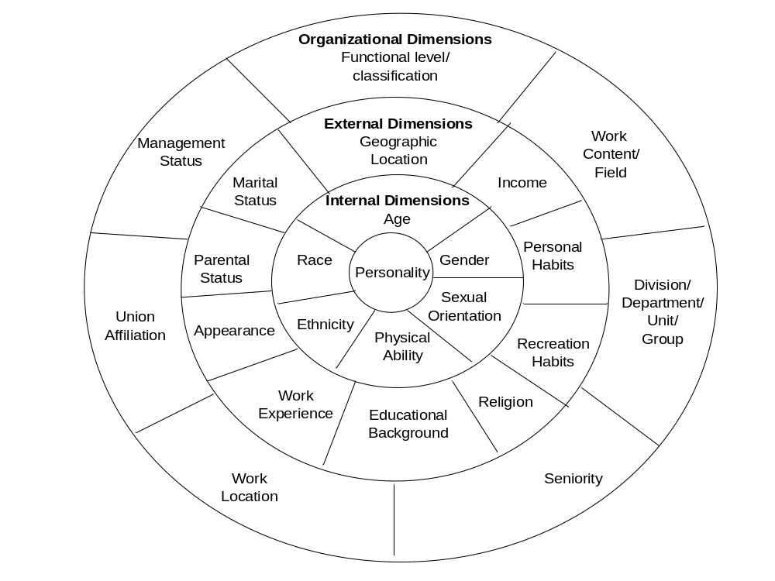
The Diversity Wheel
13-<number>
Copyright 2012 John Wiley & Sons, Inc.

